Slide 1

Important College Facts for Students

Slide 2
Overview
Why Should You Go To College?
  College is the pathway to success and a better life
  College graduates earn more money and get better jobs
  Unemployment rates are lower for college graduates
  College will help you help your family
  College is a lot of fun!
A Who’s Who of Famous College Graduates
How Do You Pay for College?
College Facts – Student Presentation
www.fastweb.com
Page 2

Slide 3
Pathways to Success and a Better Life
College opens doors to opportunity and expands your horizons.
Graduating from college will be a source of pride because it is a great accomplishment.
You get to follow your dreams and determine your future!
College Facts – Student Presentation
www.fastweb.com
Page 3

Slide 4
College Graduates Earn More Money
College Facts – Student Presentation
www.fastweb.com
Page 4

Slide 5
Earn More Staying School
High school graduates earn $430,000 more over their lifetimes than high school dropouts.
Double your income by graduating from college.
  An Associate’s degree is worth $390,000 more than a high school diploma.
  A Bachelor’s degree is worth $1.2 million more than a high school diploma.
  A Doctorate (Ph.D.) is worth $1.7 million more than a Bachelor’s degree.
  A Professional (law or medical) degree is worth $2.9 million more than a Bachelor’s degree.
College Facts – Student Presentation
www.fastweb.com
Page 5

Slide 6

College is a Pathway to Opportunity
In a global economy where the most valuable skill you can sell is your knowledge, a good education is no longer just a pathway to opportunity – it is a prerequisite.
– President Barack Obama
College Facts – Student Presentation
www.fastweb.com
Page 6

Slide 7
College is Required for a Better Job
All of the highest paying jobs require a college degree.
Jobs for college graduates include better benefits, such as health insurance and retirement plans.
College graduates have half the unemployment rates of high school graduates and better job security.
There are many more jobs available for college graduates than high school graduates.
College Facts – Student Presentation
www.fastweb.com
Page 7

Slide 8
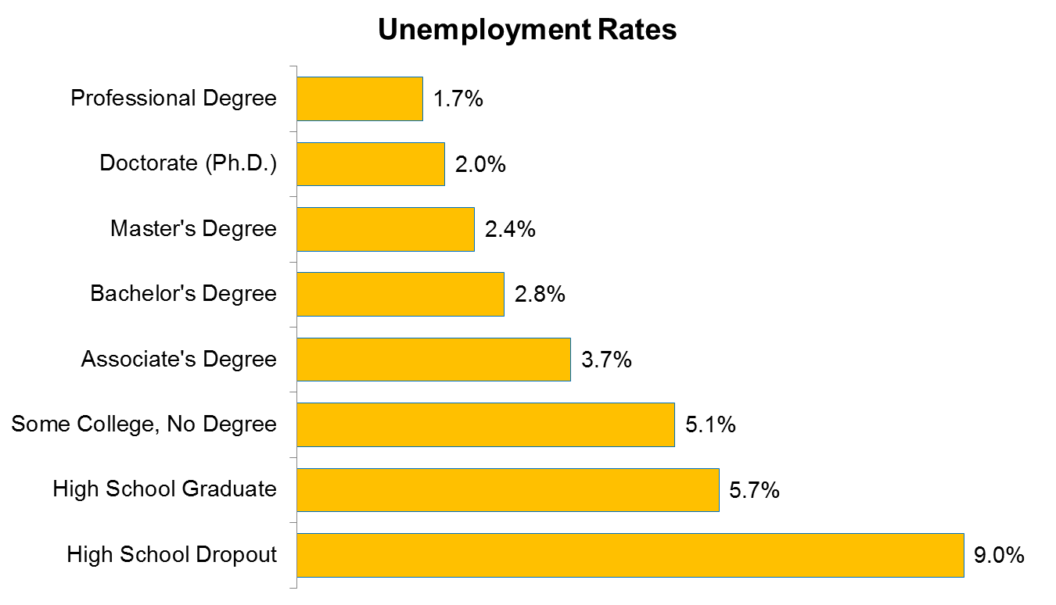
College = Lower Unemployment Rate
College Facts – Student Presentation
www.fastweb.com
Page 8

Slide 9
College Helps You Help Your Family
You will be able to support your family with a larger salary.
You will pave the way for your brothers and sisters and other relatives to go to college.
You will be able to help your children with their homework and give them a better life. As a result, they will be more likely to attend college.
College Facts – Student Presentation
www.fastweb.com
Page 9

Slide 10
College is a Lot of Fun!
You get to do amazing things and to train for a job you will enjoy. There are many activities on college campuses.
You will meet smart and interesting people and make lifelong friends.
At college, it is cool to be smart. You will learn how to think and express yourself more clearly and solve important problems. You will become more confident.
College Facts – Student Presentation
www.fastweb.com
Page 10

Slide 11

Equal Opportunity
In our democracy every young person should have an equal opportunity to obtain a higher education, regardless of his station in life or financial means.
– President John F. Kennedy
College Facts – Student Presentation
www.fastweb.com
Page 11

Slide 12
Famous College Graduates
Kareem Abdul-Jabbar – UCLA
Bill Clinton – Georgetown
Hillary Clinton – Wellesley
Bill Cosby – Temple University
Gloria Estefan – Univ. of Miami
Jodie Foster – Yale
Louis Gossett, Jr. – NYU
Hugh Hefner – Univ. of Illinois
Magic Johnson – Michigan St.
Tommy Lee Jones – Harvard
John F. Kennedy – Harvard
Martin Luther King Jr. – BU
Spike Lee – Morehouse, NYU
Jay Leno – Emerson College
David Letterman – Ball State
Bill Nye – Bridgewater State
Shaquille O'Neal – LSU
Barack Obama – Occidental
Natalie Portman – Harvard
Colin Powell – CUNY, GWU
Ronald Reagan – Eureka
J. K. Rowling – Univ. of Exeter
Sonia Sotomayor – Princeton
Julia Stiles – Columbia
Sigourney Weaver – Stanford
Oprah Winfrey – Tenn. State
College Facts – Student Presentation
www.fastweb.com
Page 12

Slide 13
How Do You Pay for College?
Student financial aid helps you pay the college bills
Five types of student financial aid
Scholarships are about more than just money
How do you find scholarships?
How do you apply for scholarships?
How do you apply for need-based aid?
Pitfalls: Beware of scholarship scams!
College Facts – Student Presentation
www.fastweb.com
Page 13

Slide 14

Covering College Costs
Education costs money, but then so does ignorance.
– Sir Claus Moser
College Facts – Student Presentation
www.fastweb.com
Page 14

Slide 15
Student Financial Aid Pays the Bills
College isn’t as expensive as you might think.
There’s a lot of money available to help you pay for college.
Student financial aid will help you bridge the gap between college costs and what you and your family can afford to pay.
Student aid includes money from the federal and state government, from colleges themselves, and scholarships from foundations, private organizations and companies.
College Facts – Student Presentation
www.fastweb.com
Page 15

Slide 16
Five Types of Student Financial Aid
Gift aid, such as grants and scholarships, which is free money that does not need to be repaid.
Student employment, such as part-time work-study jobs, which lets you earn as you learn.
Student loans, which is money that is repaid over several years, usually with interest.
Education tax benefits, such as the Hope Scholarship tax credit, which is money you get by filing a federal income tax return, even if you don’t owe any taxes.
Military student aid, such as ROTC and the GI Bill, where you earn money for your education in exchange for service in the United States Armed Forces.
College Facts – Student Presentation
www.fastweb.com
Page 16

Slide 17
The Best Type of Student Aid
Grants and scholarships are better than student loans because you don’t have to pay them back!
  Some funds are awarded based on financial need (the difference between the costs and ability to pay)
  Some funds are based on academic, artistic or athletic merit or other skills and activities
  Some funds are based on unusual criteria
    Creating a prom costume out of duct tape
    A scholarship for left-handed students
    A scholarship for students with a last name of Zolp
College Facts – Student Presentation
www.fastweb.com
Page 17

Slide 18

College is a Passport to the Future
Education is our passport to the future, for tomorrow belongs to the people who prepare for it today.
– Malcolm X
College Facts – Student Presentation
www.fastweb.com
Page 18

Slide 19
More Than Just Money
The organizations that award scholarships are focused on more than just giving away money.
They want to eliminate barriers to college success.
Many try to build a community of their scholarship recipients.
  You will meet people just like yourself and make lifelong friends.
  You get someone to talk to, someone you can trust.
College Facts – Student Presentation
www.fastweb.com
Page 19

Slide 20
How Do You Find Scholarships?
Use a free online scholarship match service like www.Fastweb.com.
  Fastweb matches your profiles personal characteristics against a very large database of scholarships, so you will see only those scholarships for which you are qualified.
  The Fastweb database is updated daily, with automatic email notification of new awards that match your profile.
  Fastweb also provides college resources such as information on financial aid, college admissions, internships and more.
College Facts – Student Presentation
www.fastweb.com
Page 20

Slide 21
More Ways to Find Scholarships
Your guidance counselor might post information about scholarships outside his/her office or on the school web site.
Some guidance counselors publicize scholarships in the school bulletin or distribute scholarship booklets.
You can also find scholarships in books in your local public library or bookstore.
source of money for college
College Facts – Student Presentation
www.fastweb.com
Page 21

Slide 22
Start Searching for Scholarships Now
Start searching for scholarships as soon as possible.
There are scholarships with deadlines throughout the year, so the sooner you start searching, the more scholarships you will find.
There are even scholarships for children in the grades K-8 in addition to scholarships for high school students in grades 9-12.
Continue searching for scholarships after you are enrolled in college.
money for college
College Facts – Student Presentation
www.fastweb.com
Page 22

Slide 23
How Do You Apply for Scholarships?
After you locate the scholarships, you will need to submit an application to each scholarship.
  Many scholarships require short essays, letters of recommendation and high school transcripts.
  If you become a finalist, some scholarships will conduct an in-person or telephone interview.
If you win the scholarship, the sponsor will hold the money until you have enrolled in college. They will then send a check to you and/or to the college to help you with your college costs.
College Facts – Student Presentation
www.fastweb.com
Page 23

Slide 24
Don’t Lose Your Scholarship
Some scholarships are renewable, which means you get money every year you are in college.
Often, you will need to get good grades to keep the scholarship and send a short progress report to the sponsor once a year.
You might also need to get involved in community service or other activities.
College Facts – Student Presentation
www.fastweb.com
Page 24

Slide 25

Knowledge is an Investment
If a man empties his purse into his head, no one can take it from him. An investment in knowledge always pays the highest return.
– Benjamin Franklin
College Facts – Student Presentation
www.fastweb.com
Page 25

Slide 26
How do you Apply for Need Based Aid?
Submit the Free Application for Federal Student Aid (FAFSA) online at www.fafsa.ed.gov to apply for need-based grants, loans and work-study.
The FAFSA is used to calculate your “expected family contribution” or EFC, a measure of your family’s annual ability to pay for college.
  A lower EFC makes you eligible to receive more need-based financial aid, such as the Federal Pell Grant.
  Financial Need = Cost of Attendance – EFC
  Students with a lower EFC qualify for more financial aid.
  Students with a zero EFC (mostly students with family income less than $30,000) have full financial need and qualify for even more financial aid to help pay for school.
College Facts – Student Presentation
www.fastweb.com
Page 26

Slide 27
Beware of Scholarship Scams
Beware of scholarships that charge any kind of an application fee, even if it is just a few dollars.
  Don't invest more than a postage stamp for information about scholarships or to apply for scholarships.
  If you have to pay money to get money
  it’s probably a scam.
  Don’t give out your Social Security number, bank account number, credit card number or debit card number to any scholarship providers.
Nobody can guarantee that you will win a scholarship.
College Facts – Student Presentation
www.fastweb.com
Page 27

Slide 28
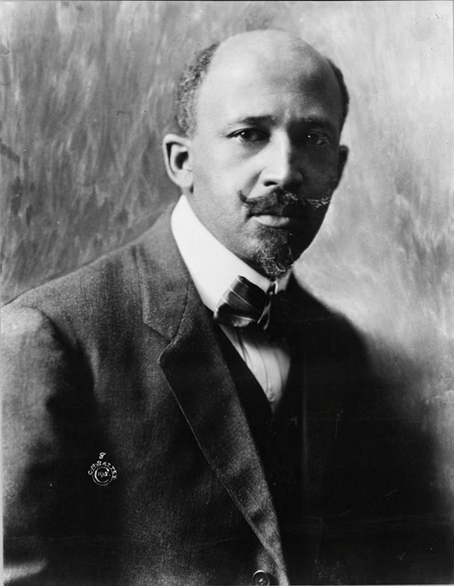
The Function of The University
The function of the university is not simply to teach bread-winning, or to furnish teachers for the public schools or to be a centre of polite society; it is, above all, to be the organ of that fine adjustment between real life and the growing knowledge of life, an adjustment which forms the secret of civilization.
– W.E.B. DuBois
The Souls of Black Folk
College Facts – Student Presentation
www.fastweb.com
Page 28

Slide 29
Thank you!

